Slide 1
Howto – Programming Modern Windows
Sudhansu Sekhar Sutar

Slide 2
Contents
Platforms for Windows App
Development Platforms Details
Windows Development Target
UWP Bridge Technology
Microsoft Project Reunion
Modern Windows API Stack
API Set/Framework Library
Language Selection for Development
Windows UI Library (WinUI)
WinUI3 Release Roadmap
Install WinUI 3 Preview 1
WinUI3 Project Template Types
Exercise (Simple Calculator) Using WinUI
XAML Controls Gallery App
Development Technology Evolution
Microsoft Open Sourced Technology
References

Slide 3
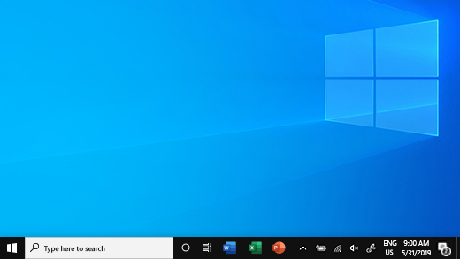




Platforms for Windows App
There are four core platforms for building apps for Windows PCs (MFC, WinForms, WPF, & WinUI). Each of the platform provides an app model that defines the lifecycle of the app, a complete UI functional framework and set of UI controls to apps.

Slide 4
Development Platforms Details
Platform | Description
MFC (Microsoft Foundation Class) | It gets you "closer to the metal," and lets you achieve the best performance for your app by taking direct control over memory allocation and performance oriented CPU features like SSE or AVX instructions. MFC provides a light non VM class abstraction over the Win32/COM Native API. The only supported language for MFC application development is VC++. MFC is suitable for write application like Word, Excel, Visio, photo shop, Windows System programs, Device Drivers, and Multimedia/Game development using DirectX.
WinForms (Windows Forms) | Windows Forms is the dominant RAD (Rapid Application Development) framework for building Windows smart client applications. It has initially introduced with .Net Framework 1.x. Windows Forms is easier to use and is a light weight UI model. Applications using WinForms can be developed using languages such as VC++/VB/C#. UI of some of the past version of Visual Studio (2000 ~ 2008) are developed using WinForms. It is a good choice of framework for development of business oriented desktop applications.
WPF (Windows Presentation Foundation) | WPF is the preferred technology for building Windows rich client applications that require UI complexity, styles customization, and graphics-intensive. It has a very powerful Templating, Styling, and data Binding capabilities with the support of XAML UI model. It has initially introduced with .Net Framework 3.x. Applications using WPF can be developed using languages such as VB/C#. UI of latest version of Visual Studio series (2010 ~ 2019) are developed using WPF.
WinUI (Windows UI Library) | The leading-edge framework for Windows apps development. It has originated as UX layer of UWP/WinRT platform, and finally decoupled as independent UX framework at Version 3.0. WinUI can be used in existing MFC, WinForms, or WPF apps to modernize them and gradually migrate, or develop complete WinUI based application from scratch for desktop or UWP. The supported languages are VC++/VB/C#/JS. WinUI uses XAML UI model, so code port possible among WPF, WinRT, UWP, and WinUI.

Slide 5
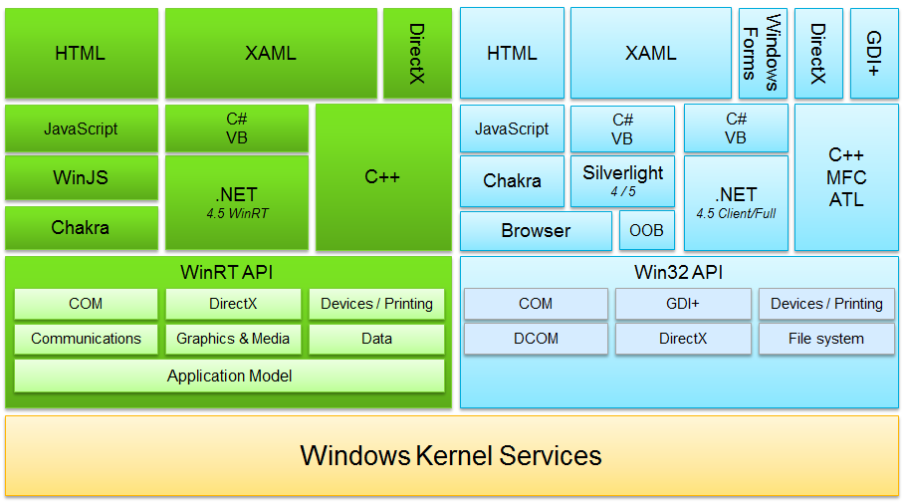
Windows Development Target
There are two kinds of applications windows natively supports “1-Full Trust Win32/Desktop” Application, and “2-WinRT/UWP Sandboxed” application. A “Full Trust Win32/Desktop” app can also be sandboxed using the bridge technology.

Slide 6
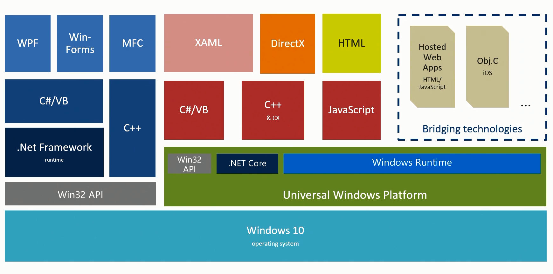
UWP Bridge Technology
UWP Bridges translate calls in other application programming interfaces (APIs) to the UWP interface, so that applications written in these APIs would run on UWP. Bridges are available to run Android, iOS, Windows desktop apps, Microsoft Silverlight, and progressive web apps on UWP.

Slide 7
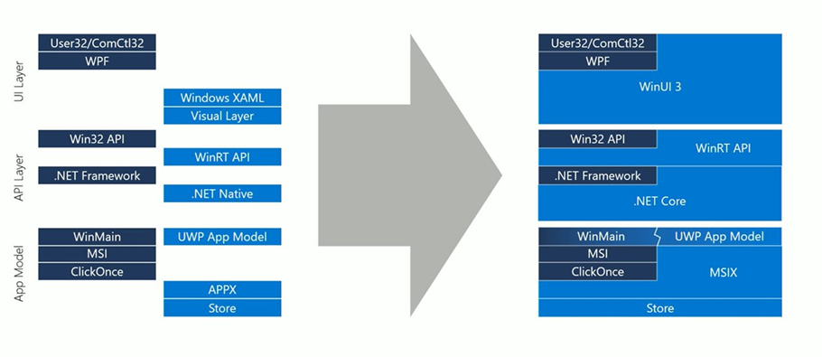
Microsoft Project Reunion
Project Reunion is an umbrella project that makes it easier to build a great Windows app by providing a unified platform for new and existing Win32 and UWP apps. It will unify access to existing Win32 and UWP APIs and make them available decoupled from the OS. Some of the components of project reunion are: WinUI3, WebView2, MSIX, and Modern Resource Tooling.

Slide 8
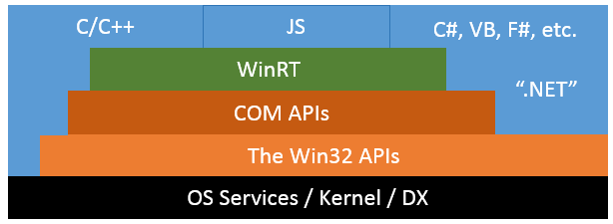
Modern Windows API Stack
VC++, MFC, ATL, WTL, C++/CX, C++/WinRT, WRL
C#, VB, F# , C++/CLI
WinForms, WPF, WinUI

Slide 9
API Set/Framework Library
System | DLL/Library | Library Type | Example
Win32 | Api-ms-Win-*.dll | Native C
WinRT/ UWP | Windows.*.dll | COM/DCOM Library
WinUI | Microsoft.ui.*.dll | COM/DCOM Library
dotnet | System.*.dll | .Net CLI Assembly

Slide 10
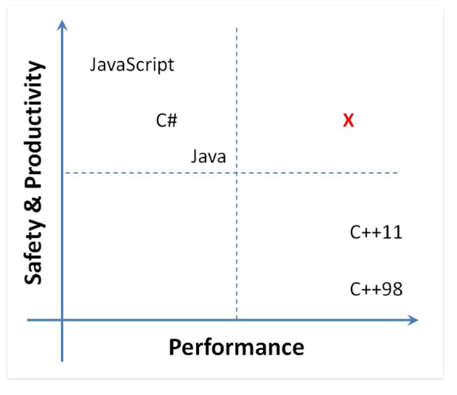
Language Selection for Development

Slide 11
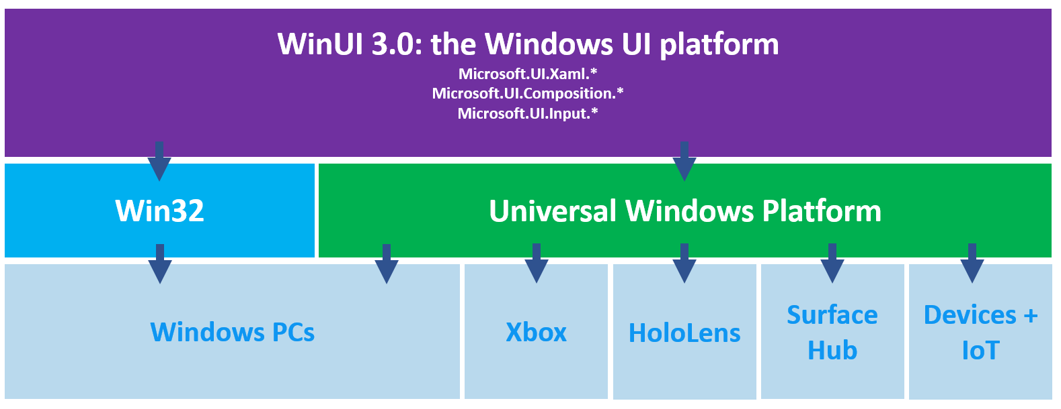
Windows UI Library (WinUI)
The leading-edge framework for Windows apps development. It has evolved from the UX layer of UWP/WinRT platform to a complete and independent UX framework. WinUI can be used in existing MFC, WinForms, or WPF apps to modernize and gradually migrate. WinUI used to develop application from scratch for desktop or UWP.

Slide 12
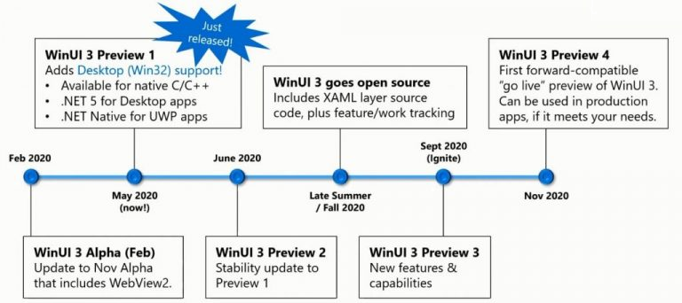
WinUI3 Release Roadmap

Slide 13
Install WinUI 3 Preview 1
1) Ensure that your development computer has Windows 10, version 1803 (build 17134), or a later version installed.
WinUI 3 for desktop apps requires 1803 or a later OS version.
2) Install Visual Studio 2019, version 16.7 Preview 1
Install Visual Studio 2019, version 16.7 Preview 1. You can download this from Visual Studio Preview.
You must include the following workloads when installing the Visual Studio Preview:
.NET Desktop Development
Universal Windows Platform development
To build C++ apps you must also include the following workloads:
Desktop development with C++
The C++ (v142) Universal Windows Platform tools optional component for the Universal Windows Platform workload
3) Install .NET 5 Preview 4
Install both x64 and x86 versions of .NET 5 Preview 4:
x64: https://aka.ms/dotnet/net5/preview4/Sdk/dotnet-sdk-win-x64.exe
x86: https://aka.ms/dotnet/net5/preview4/Sdk/dotnet-sdk-win-x86.exe
4) Install WinUI 3 Preview 1 Visual Studio project templates
To access the WinUI 3.0 Preview 1 and project templates, go to https://aka.ms/winui3/previewdownload
Download the Visual Studio Extension (.vsix) to add the WinUI project templates and NuGget package to Visual Studio 2019 and install it. After installing the .vsix extension you can create and build WinUI based application.

Slide 14
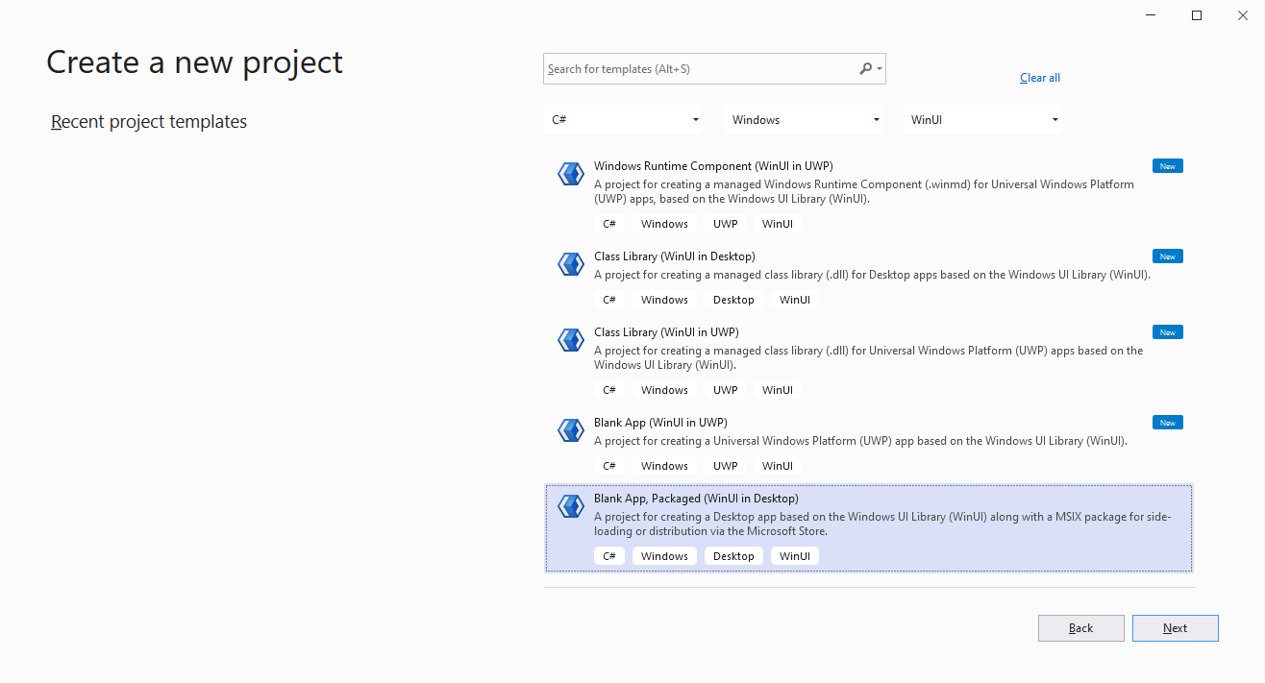
WinUI3 Project Template Types
Open “Create new project” Visual Studio Wizard, use filer “Language: C#, Platform: Windows, Project Type: WinUI” to list out the supported WinUI Template. You can select “Blank App, packaged (WinUI in Desktop)” to create a sample desktop application.

Slide 15
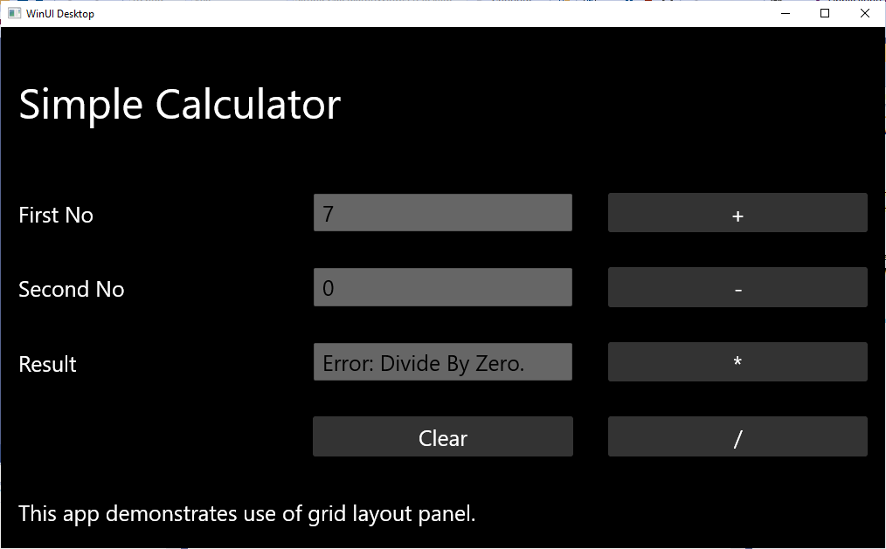
Exercise (Simple Calculator) Using WinUI
The Source Code of the sample can be found at - https://github.com/SUDHANSUX/SimpleCalculator/

Slide 16
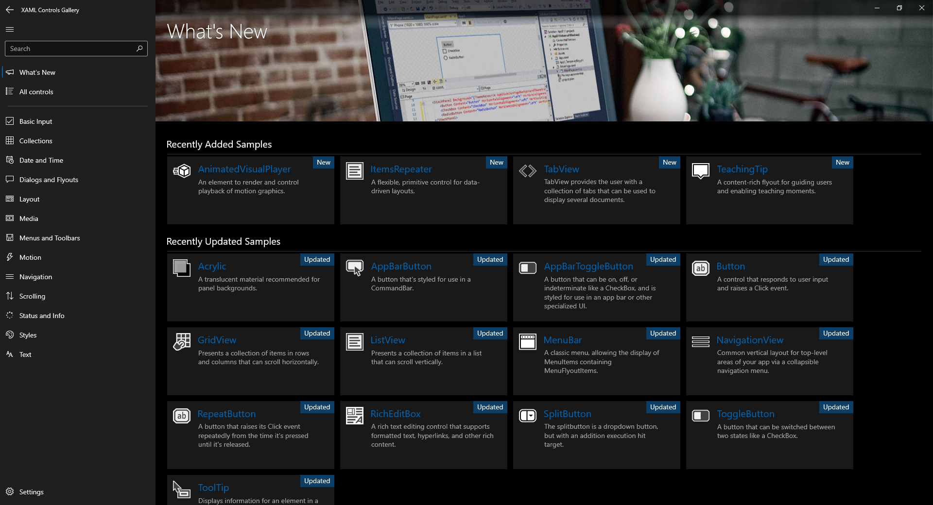
XAML Controls Gallery App
This app demonstrates all of the Xaml and Windows UI library controls available to make a Fluent Windows app. To learn more about the Windows UI library and how you can integrate it into your application, visit: https://aka.ms/winui

Slide 17
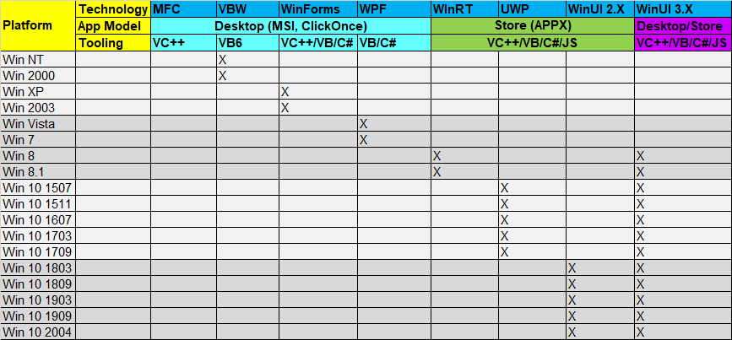
Development Technology Evolution

Slide 18
Microsoft Open Sourced Technology
Technology | Platform | Project Home
.Net Core | Windows, Linux, macOS | https://github.com/dotnet/core
WinForms | Windows Desktop (.Net Fx 1.x) | https://github.com/dotnet/winforms
WPF | Windows Desktop (.Net Fx 3.x) | https://github.com/dotnet/wpf
WinUI | UWP (Desktop, Mobile, IoT) (.Net Fx 4.x, .Net Core Fx 3.x) | https://github.com/microsoft/microsoft-ui-xaml
MAUI | Desktop & Mobile (Windows, Android, iOS) (.Net Core Fx 6.x) | https://github.com/dotnet/maui
EF Core | Windows, Linux, macOS | https://github.com/dotnet/efcore
ASP.Net Core | Windows, Linux, macOS | https://github.com/dotnet/aspnetcore

Slide 19
References
https://docs.microsoft.com/en-us/windows/apps/winui/
https://docs.microsoft.com/en-us/windows/apps/desktop/modernize/xaml-islands
https://docs.microsoft.com/en-us/windows/win32/appuistart/user-interface-technologies-for-windows-applications
https://docs.microsoft.com/en-us/windows/uwp/porting/android-ios-uwp-map

Slide 20
END OF FILE

